Slide 1

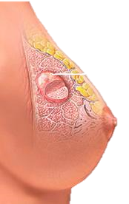
Breast Cancer
Prediction
Notes:
There are certain characteristics in cell nuclei that will be used to determine the likelihood of breast cancer in patients.
These cell nuclei are collected using Fine Needle Aspiration (FNA) of breast masses.
These breast masses are extracts from the breast.

Slide 2
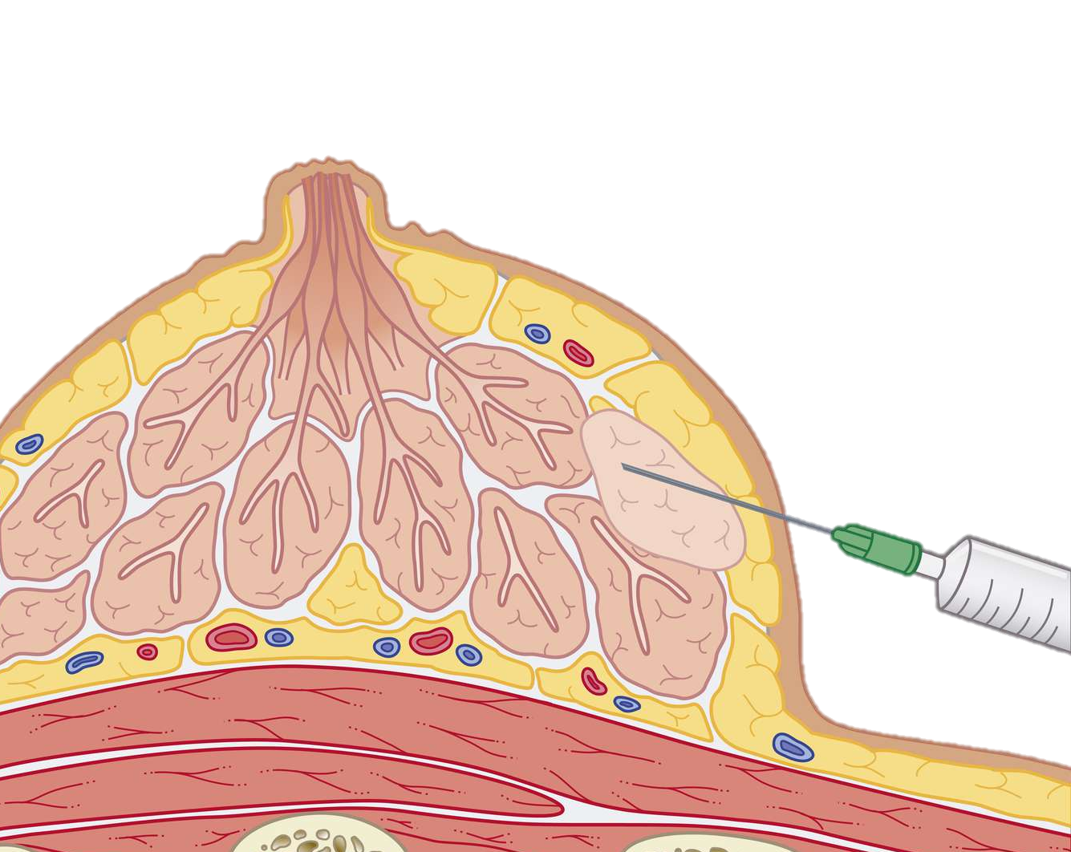
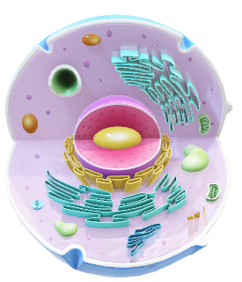
Fine Needle Aspiration (FNA) of breast masses
Cells are tiny building blocks

Slide 3
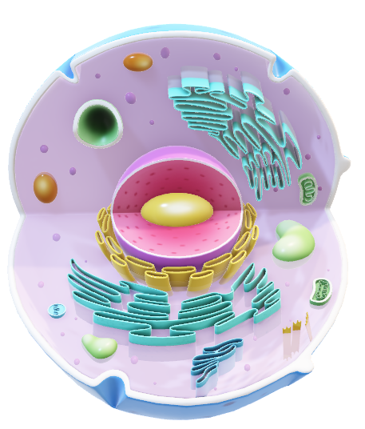
Cells are tiny building blocks
Fine Needle Aspiration (FNA) of breast masses

Slide 4

Nucleus

Slide 5

Real Valued Features of the Nucleus
‘M’
Malignant
Radius
Texture
Perimeter
Area
Smoothness
Compactness
Concave points
Symmetry
Fractal dimension
Fractal geometry
Benign
‘B’
Fine Needle Aspiration (FNA) of breast masses

Slide 6
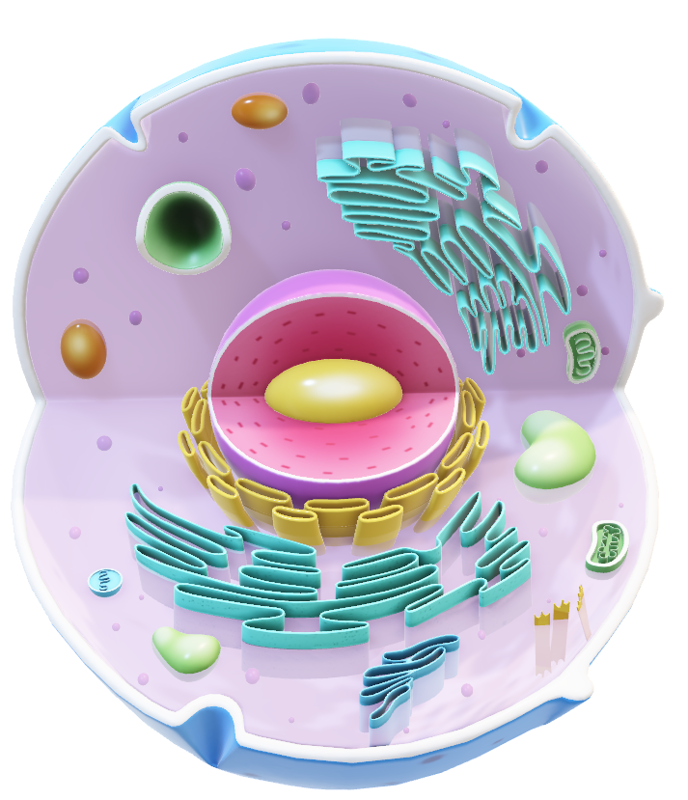
‘M’
Malignant
DATASET
DESCRIPTION
Benign
‘B’
Dataset Description
Real Valued Features of Nucleus
ID Number
Diagnosis
Radius
Texture
Perimeter
Area
Smoothness
Compactness
Concave points
Symmetry
Fractal dimension
Fractal geometry

Slide 7
Checked for missing values
Converted diagnosis to binary
Checked for duplicate rows
33
Number of Columns
3
Column Categories
10
No. features each
Mean
Std. Error
Worst Values
Data examination
Data cleaning

Slide 8
Checked for missing values
Converted diagnosis column to binary.
Checked for duplicate rows
33
Number of Columns
3
Column Categories
10
No. features each
Mean
Std. Error
Worst Values
Data examination
Data cleaning

Slide 9
Correlation Between
Diagnosis and Variables
100th
75th
PERCENTILE
25th
0th
Radius
Texture
Perimeter
Area
Smooth
Compact
Con Points
Symmetry
Frac dim
Frac geo

Slide 10
Training Models
Logistic Regression (0.97)
Support Vector Machine (0.96)
Gradient Boosting Classifier (0.96)
Artificial Neural Network (0.96)
Random forest (0.95)
K-Nearest Neighbors (0.95)
Naïve Bayes (0.95)
Decision Tree (0.95)
Logistic Regression
97%
Accuracy

Slide 11
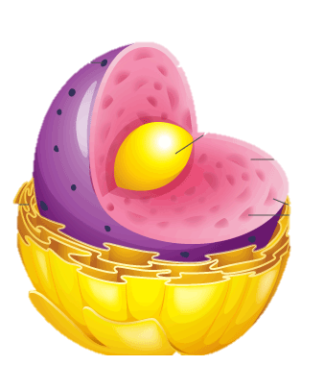
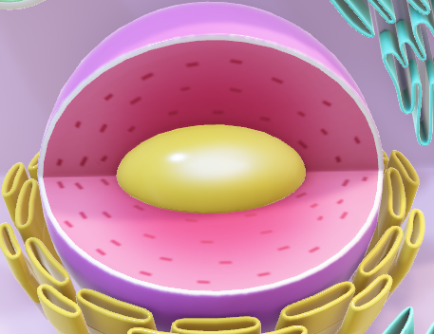
Radius
Texture
Perimeter
Area
Smoothness
Compactness
Concave points
Symmetry
Fractal dimension
Fractal geometry
Benign
Malignant
Notes:
Unit of measure is micrometres µm

Slide 12
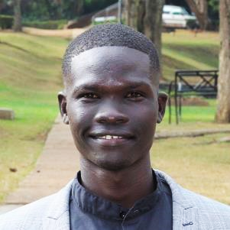


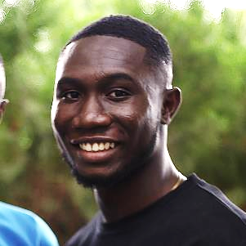
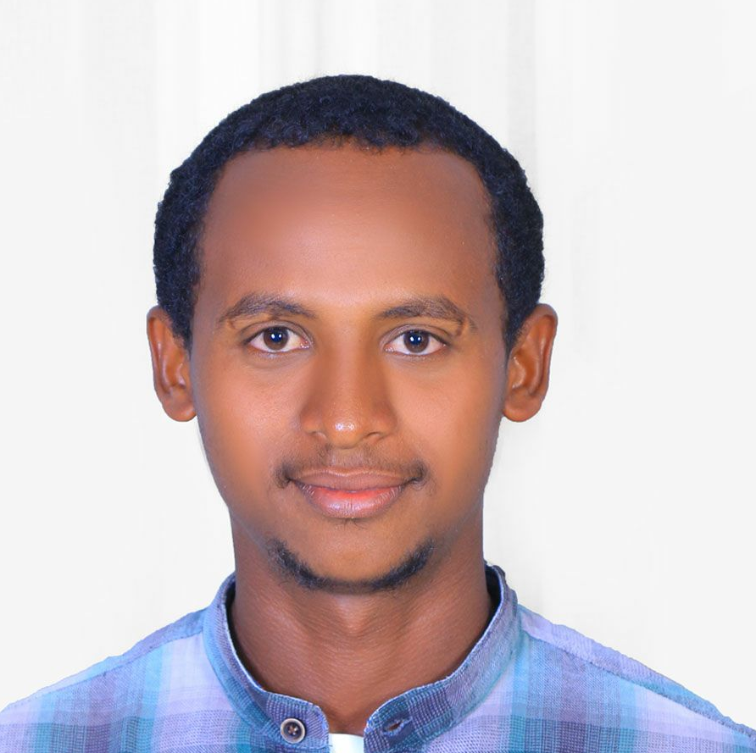
TEAM
SOS Pi Group 4

Slide 13

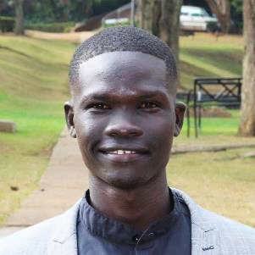

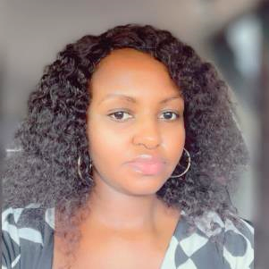

TEAM
MAVIS
Our lovely head tutor 💕

Slide 14
Thank you!
SOS Pi Group 4

Slide 15

Benign Characteristics
Malignant Characteristics

Slide 16
Todos
Reduce technical jargons.
Explain that breast masses are extracted and cells in these masses are viewed to check the characteristic of their nucleus.
Train a model to predict based on learned data.
Being able to predict breast cancer.
Logistic regression, with 97% accuracy to make the prediction.

